Slide 1
FUNDAMENTALS OF MACHINE LEARNING
wellcome

Slide 2

Let us take an example of a company. When people write reviews online, it's important for them to understand whether the reviews are positive, negative, or neutral.
It would be difficult for them to check each review one by one.
Machine learning helps with this by automatically analyzing the sentiment expressed in the reviews.

Slide 3
What is machine learning
is a branch of Artificial Intelligence that leverages data to improve computer performance by giving machines the ability to learn.
The science of getting computers to act without being explicitly programmed

Slide 4
How Machine Learning works here
Collecting data: We gather customer reviews from different places like online stores or social media
Preparing the text: Before teaching the machine, we clean up the text by removing unnecessary things like punctuation
Finding patterns: We teach the machine to recognize patterns in the prepared text and link them to positive, negative, or neutral sentiments.
This is done by showing the machine many examples of reviews
Checking accuracy: We test the machine's performance by giving it new reviews that it hasn't seen before and checking if it correctly predicts the sentiment.
Analyzing new reviews: Once the machine has been trained and tested, we can use it to analyze new reviews.

Slide 5
HOW DOES MACHINE LEARNING WORKS
Define Objective
Identify , the problem to be solved and create a clear objective
Collect Data
Collect data from any sources like
Hospitals , police , fire dept.
Prepare Data
Preparing data is a crucial step and involves building workflows to clean , match and blend the data
Select Algorithm
Train Models
Data is fed as input and the algorithm configured with the required parameters . A percent of the data can be utilized to train the model
Test model
The remaining data is utilized to test the model for accuracy.
Depend on the problem to be solved and the type of data an appropriate algorithm will be chosen
Depending on the result , improvements can be performed in the Train Model and/or Select Algorithm
Integrate Model
Publish the prepared experiment as a web service , so applications can use the model
[4]

Slide 6
Data Loading for Machine learning
Consideration
Consideration While Loading CSV data
Dataset with Headers
Dataset without Headers
Machine will automatically assign names to each column of data
EXAMPLE : IRIS-FLOWERS DATASET
Need to assign the names of each column of data manually
EXAMPLE : PIMA-INDIANS-DIABETES DATASET
→ csv data format is most common format.
→ Always consider type of comments , Delimiter and Quotes you are using while loading data

Slide 7
Method 1 : Loading data with csv
We can load both types of data sets (containing header or not) using csv reader
We need to import csv and numpy libraries
Examples as shown

Slide 8
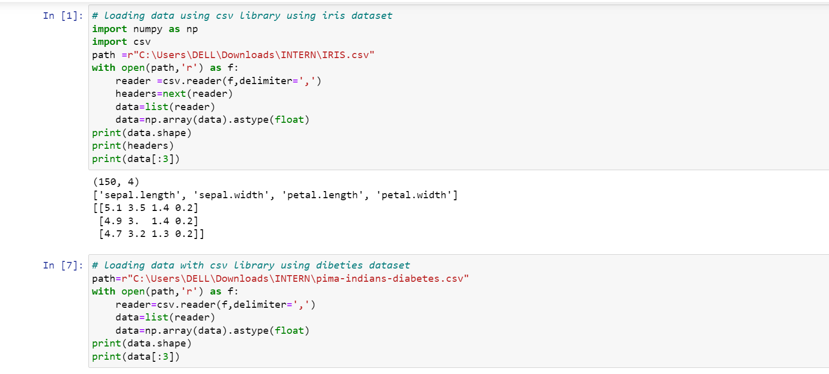
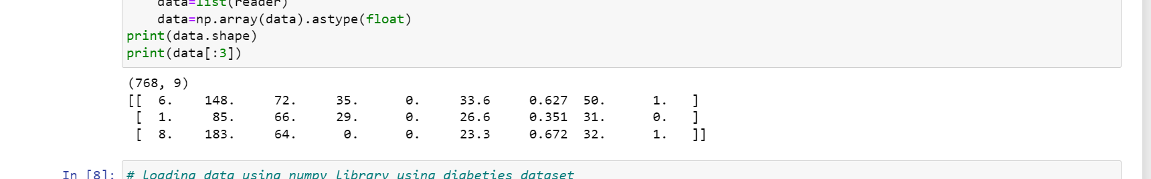

Slide 9
Method 2 : Loading data with numpy
We can use both types of data sets (containing header or not )
We need to import loadtxt from numpy library
Examples as shown

Slide 10
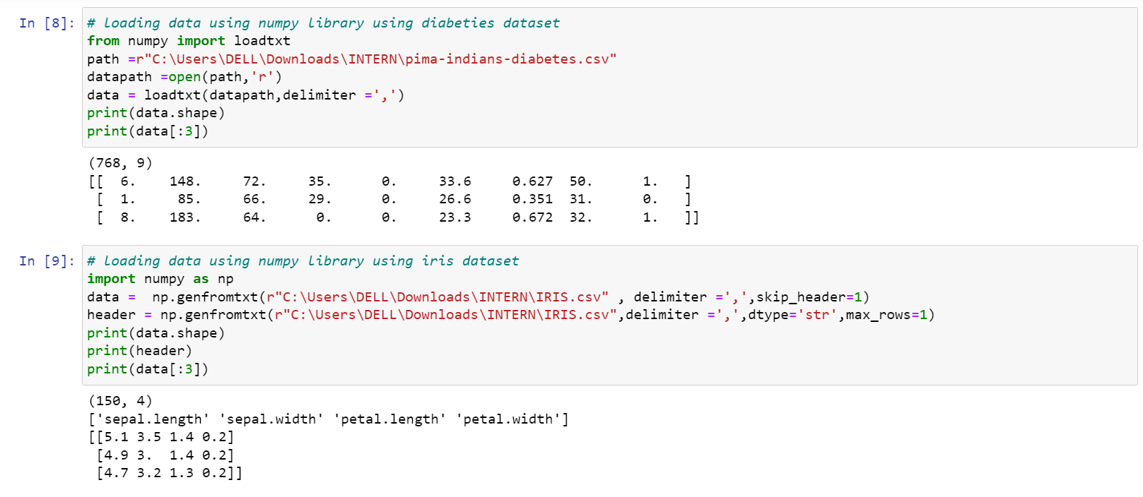

Slide 11
Loading data with pandas
We can use both types of data sets (containing header or not
We need to import read_csv() function from pandas library
This is the very flexible function that returns a pandas.DataFrame which can be used immediately for plotting.

Slide 12
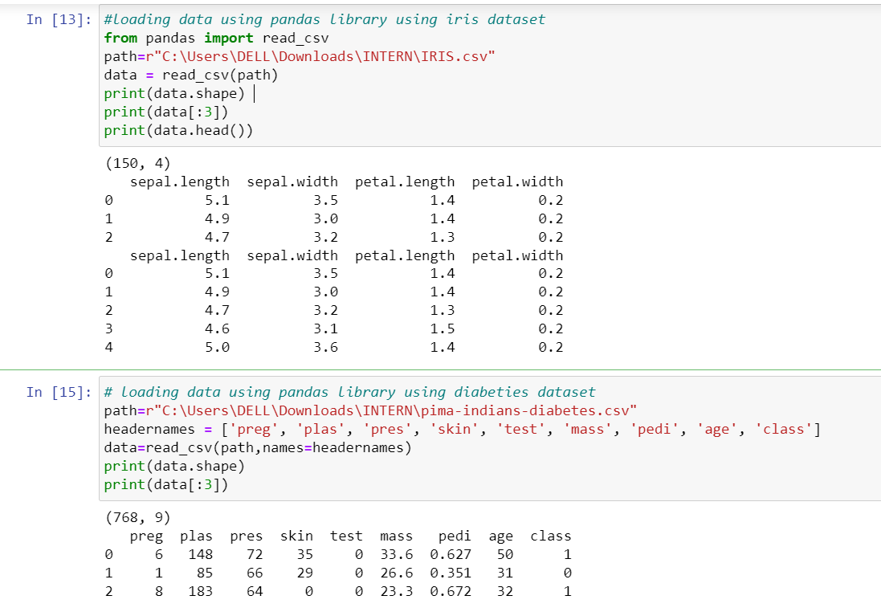

Slide 13
ML - Understanding Data
Previously ,we discussed how we can upload CSV data into our ML project, but it would be good to understand the data before uploading it.
We can understand the data by two ways, with statistics and with visualization.

Slide 14
Understanding data with statistics
1:Looking at Raw Data
It is important to look at raw data because the insight we will get after looking at raw data will boost our chances to better pre-processing as well as handling of data for ML projects.
2:Checking Dimensions of Data
It is always a good practice to know how much data, in terms of rows and columns, we are having for our ML project.
3: Getting Each Attribute’s Data Type
It is another good practice to know data type of each attribute.
As sometimes we may need to convert one data type to another

Slide 15
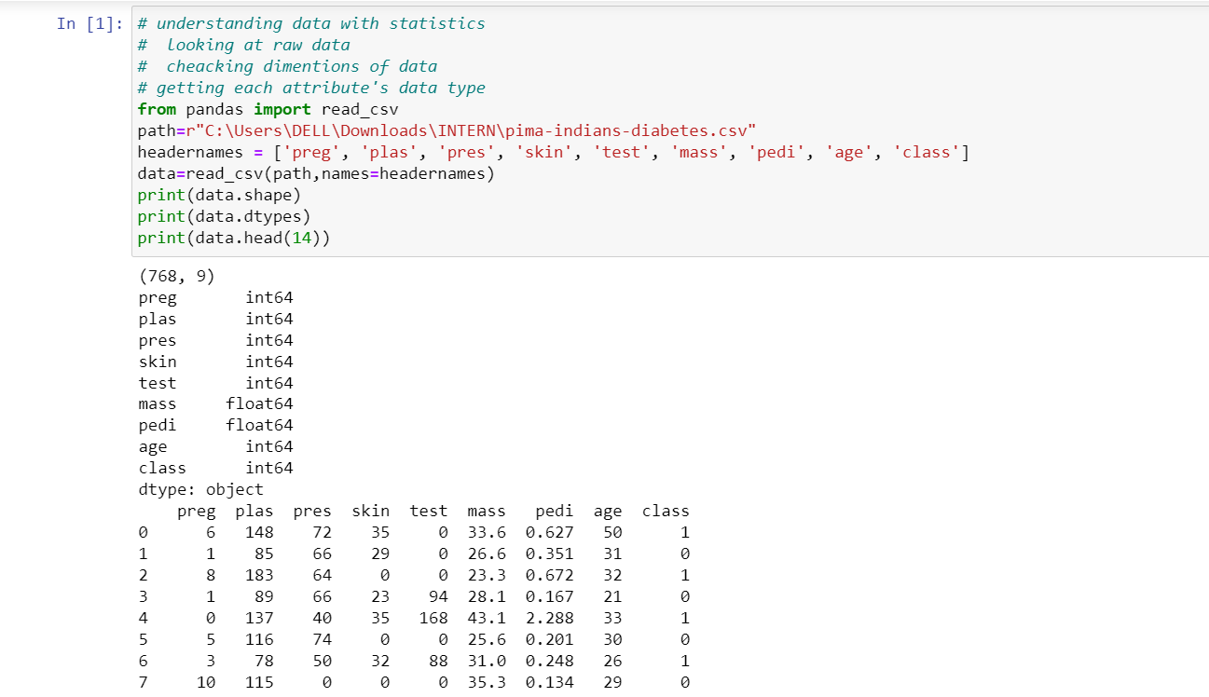

Slide 16
Statistical summery of data
Many times we need to review the summaries out of that shape of data.
It can be done with the help of describe() function of Pandas DataFrame that further provide the following 8 statistical properties of each & every data attribute
Count
Mean
Standard Deviation
Minimum Value
Maximum value
25%
Median i.e. 50%
75%

Slide 17
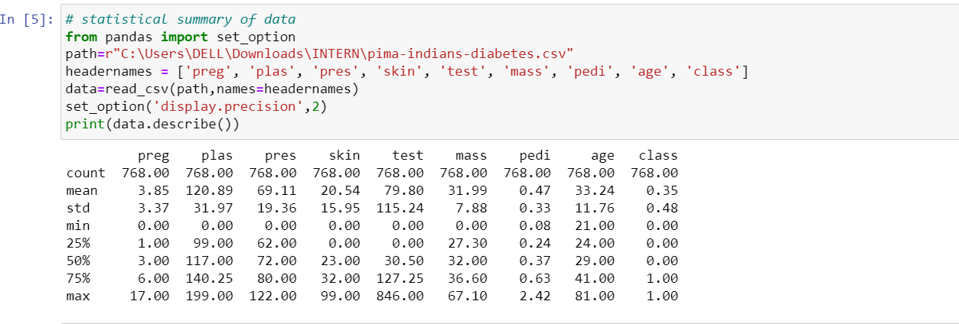
Statistical summery of data

Slide 18
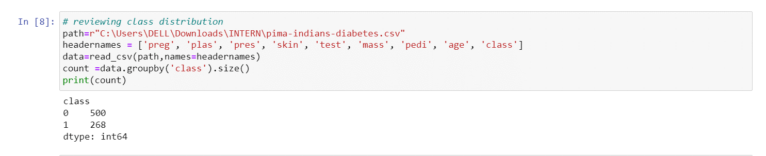
Reviewing Class Distribution
Class distribution statistics is useful in classification problems where we need to know the balance of class values.
We can easily get class distribution in Python with the help of Pandas DataFrame.

Slide 19
Reviewing Skew of Attribute Distribution
Skewness may be defined as the distribution that is assumed to be Gaussian but appears distorted or shifted in one direction or another, or either to the left or right
Importance
Presence of skewness in data requires the correction at data preparation stage so that we can get more accuracy from our model.
Most of the ML algorithms assumes that data has a Gaussian distribution i.e. either normal of bell curved data

Slide 20
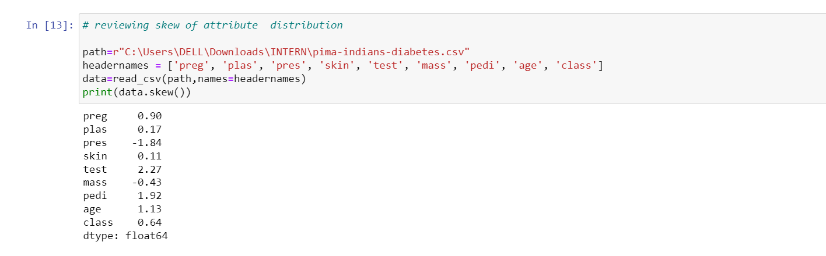
In Python, we can easily calculate the skew of each attribute by using skew() function on Pandas DataFrame.

Slide 21
Reviewing Correlation between Attributes
Relationship between two variables is called correlation.
In statistics, the most common method for calculating correlation is Pearson’s Correlation Coefficient .
It can have three values as follows − Coefficient value = 1 − It represents full positive correlation between variables.
Coefficient value = -1 − It represents full negative correlation between variables.
Coefficient value = 0 − It represents no correlation at all between variables.
It is always good for us to review the pairwise correlations of the attributes because some machine learning algorithms such as linear regression and logistic regression will perform poorly if we have highly correlated attributes

Slide 22
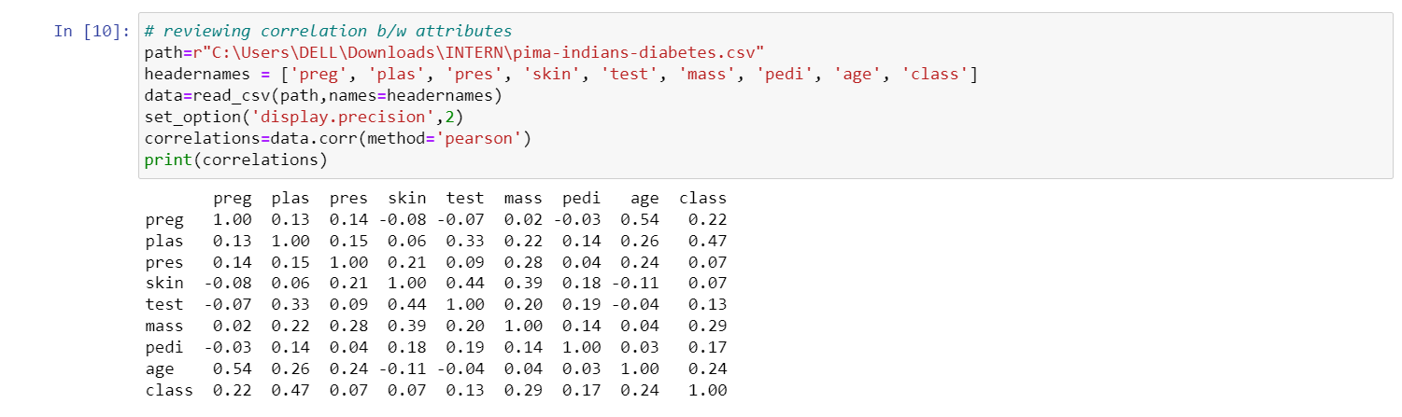
In Python, we can easily calculate a correlation matrix of dataset attributes with the help of corr() function on Pandas DataFrame

Slide 23
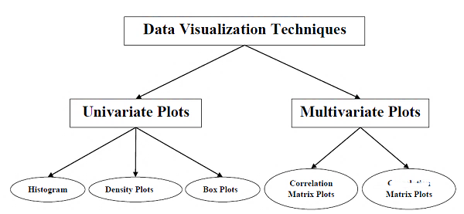
Understanding Data with Visualization
With the help of data visualization, we can see how the data looks like and what kind of correlation is held by the attributes of data.
Scatter

Slide 24
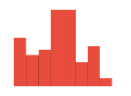
Univariate Plots: Understanding Attributes Independently
With the help of univariate visualization, we can understand each attribute of our dataset independently−
Some techniques are
1 : Histograms
Histograms group the data in bins and is the fastest way to get idea about the distribution of each attribute in dataset.
it provides us a count of the number of observations in each bin
From the shape of the bin, we can easily observe the distribution i.e. weather it is Gaussian, skewed or exponential
Histograms also help us to see possible outliers

Slide 25
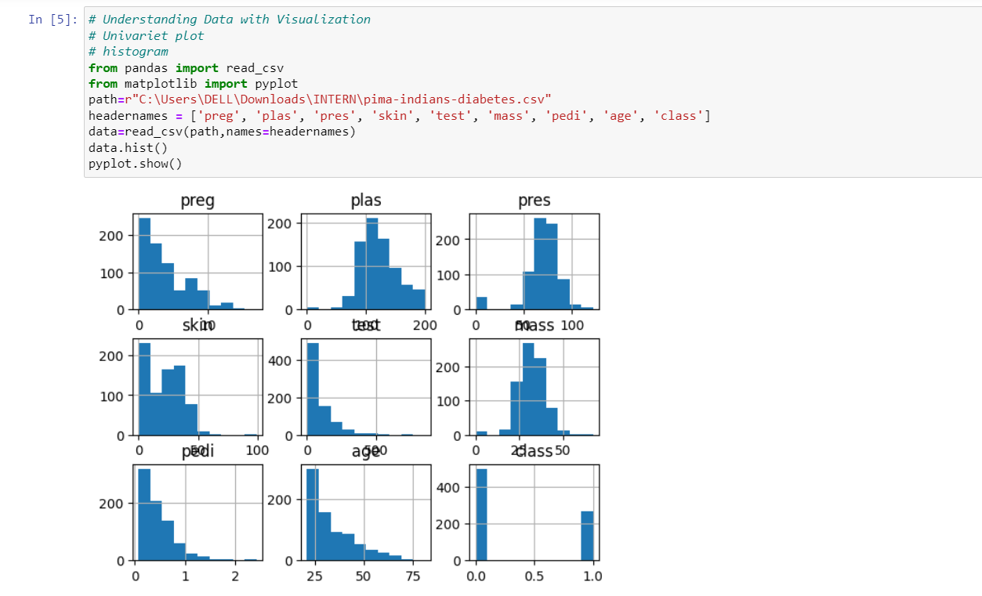
Histogram
we can observe that perhaps age, pedi and test attribute may have exponential distribution while mass and plas have Gaussian distribution.

Slide 26
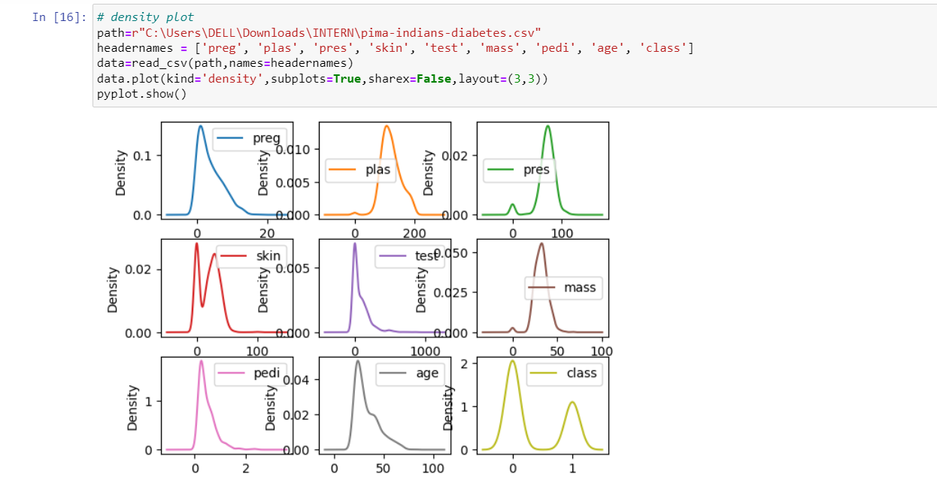
Density plots It is also like histogram but having a smooth curve drawn through the top of each bin.
the difference between Density plots and Histograms can be easily understood

Slide 27
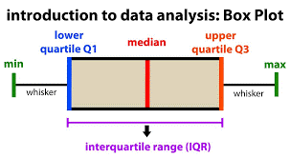
Box Plots
characteristics :−
It is univariate in nature and summarizes the distribution of each attribute.
It draws a line for the middle value i.e. for median.
It draws a box around the 25% and 75%.
It also draws whiskers which will give us an idea about the spread of the data.
The dots outside the whiskers signifies the outlier values.
Outlier values would be 1.5 times greater than the size of the spread of the middle data.

Slide 28
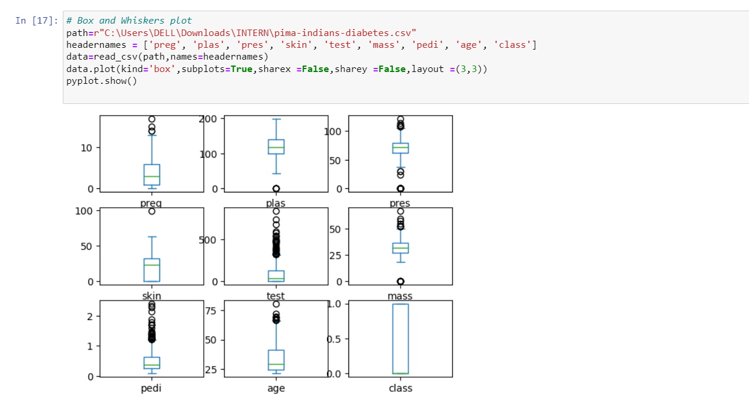
From the above plot of attribute’s distribution, it can be observed that age, test and skin appear skewed towards smaller values

Slide 29
Multivariate plots : interaction among Multiple Variables Another type of visualization . With the help of this, we can understand interaction between multiple attributes of our dataset. . The following are some techniques.
1 : Corelation Matrix Plot :
Correlation is an indication about the changes between two variables. We can plot correlation matrix to show which variable is having a high or low correlation in respect to another variable.

Slide 30
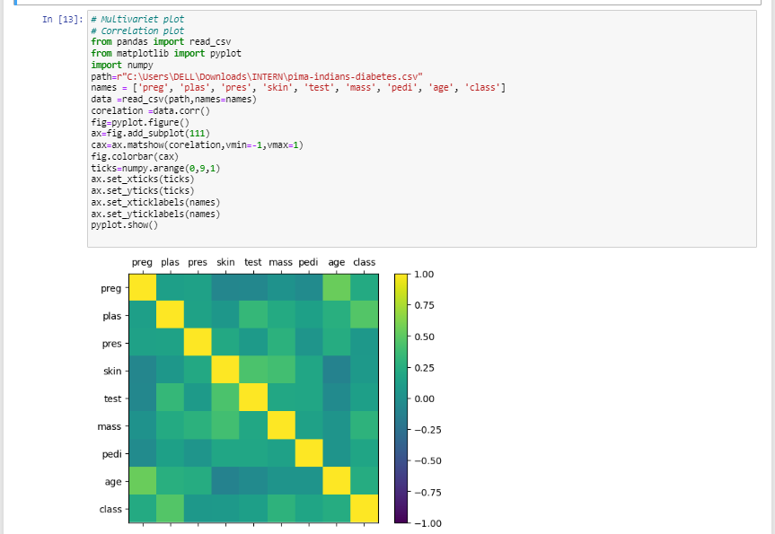

Slide 31
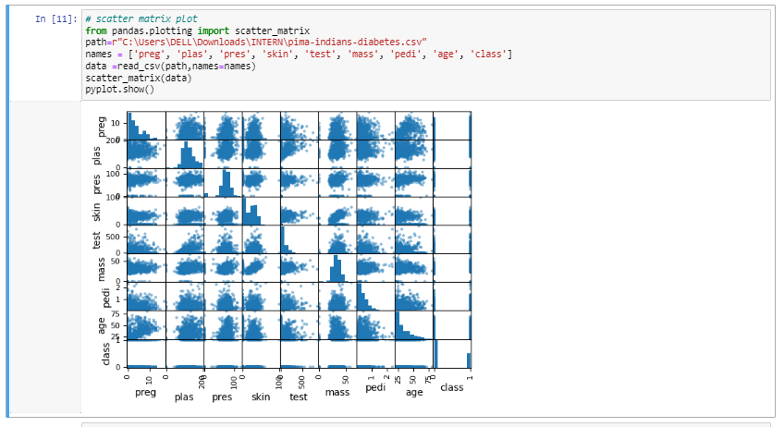
Scatter Matrix Plot
Scatter plots shows how much one variable is affected by another or the relationship between them with the help of dots in two dimensions.

Slide 32
Data Preparing / Data Preprocessing
we always need to feed right data
i.e. the data in correct scale, format and containing meaningful features, to our machine .
→Data processing convert the selected data into a form which we can feed to ML algorithms.
On the other hand that machine will be useless.

Slide 33
Data Pre-processing Techniques
1 : Scaling
Generally: attributes are of varying scale,
but we cannot provide such data to ML algorithm hence it requires rescaling.
Data rescaling makes sure that attributes are at same scale.We can rescale it between range 0-1 using MinMax scaler of scikit learn python library
ML algorithms like gradient descent and k-Nearest Neighbors requires scaled data

Slide 34
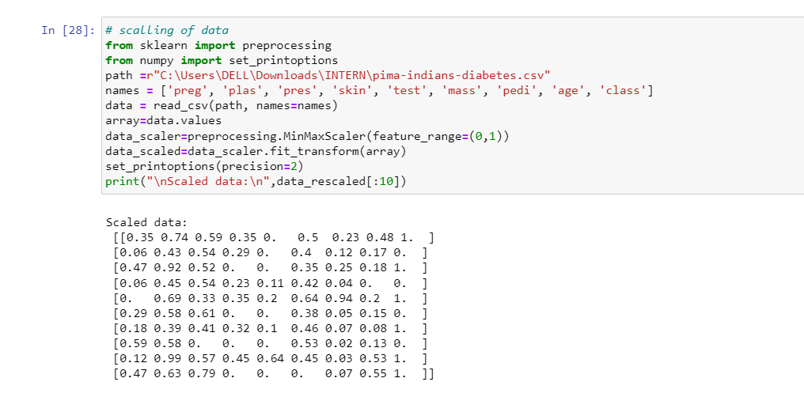
Scaling

Slide 35
Data Pre-processing Techniques
Normalization
To rescale each row of data to have a length of 1
Can be done by Normalizer class of scikit-learn Python library.
TYPES of Normalizer from sklearn.preprocessing import Normalizer
1: L1 Normalization( Least Absolute Deviations.)
RESCALE in a way that in each row the sum of the absolute values will always be up to 1.
2: L2 Normalization (least squares.)
In a way that in each row the sum of the squares will always be up to 1.

Slide 36
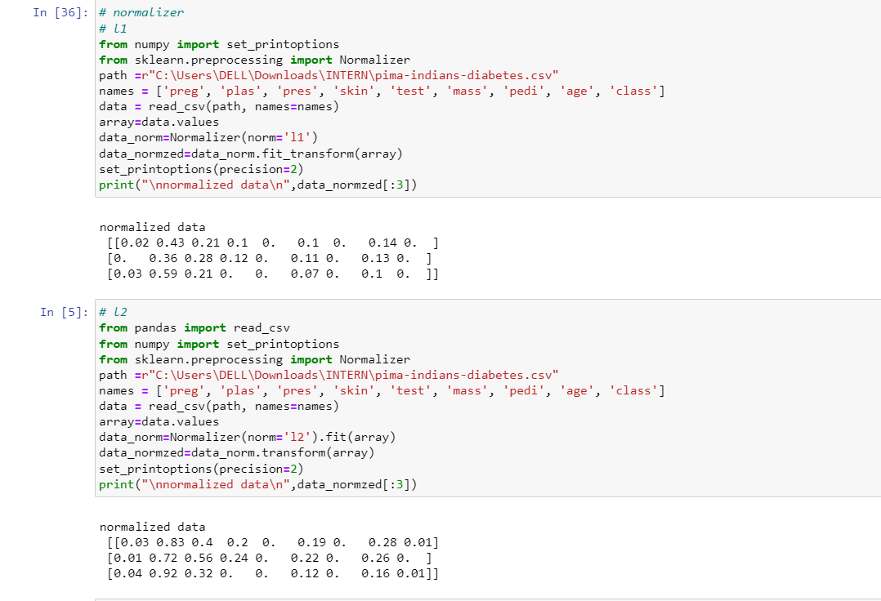
Normalizer

Slide 37
Data Pre-processing Techniques
Binarization
this is the technique with the help of which we can make our data binary. We can use a binary threshold for making our data binary. The values above that threshold value will be converted to 1 and below that threshold will be converted to 0. We can binarize the data with the help of Binarizer class of scikit-learn Python library.

Slide 38
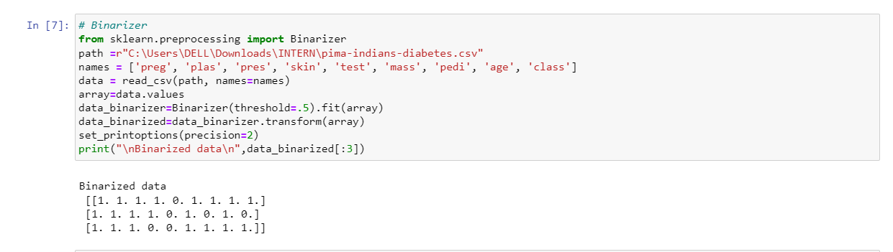
Binarization

Slide 39
Data Pre-processing Techniques
Standardization
used to transform the data attributes with a Gaussian distribution It differs the mean and SD (Standard Deviation) to a standard Gaussian distribution with a mean of 0 and a SD of 1. This technique is useful in ML algorithms like linear regression , logistic regression that assumes a Gaussian distribution In input dataset and produce better results with rescaled data. We can standardize the data (mean = 0 and SD =1) with the help of StandardScaler class of scikit-learn Python library.

Slide 40
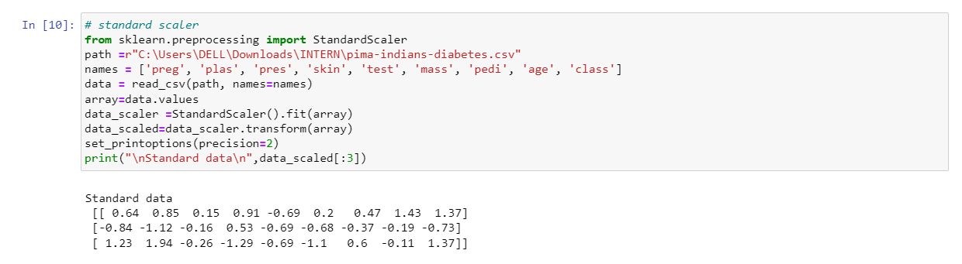
Standardization

Slide 41
Data Pre-processing Techniques
Data Labeling
It is also very important to send the data to ML algorithms having proper labeling. In case of classification problems, lot of labels in the form of words, numbers etc. are there on the data. Label Encoding: ? Most of the sklearn functions expect that the data with number labels rather than word labels. Hence, we need to convert such labels into number labels. This process is called label encoding. We can do this by using LablelEncoder of scikit learn library

Slide 42
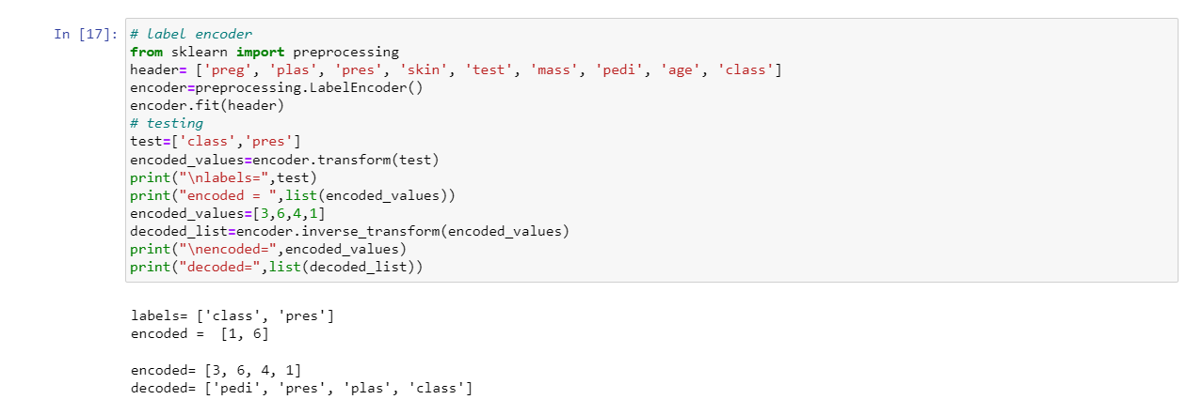
Data labelling

Slide 43

Data Feature Selection
The performance of machine learning model is directly proportional to the data features used to train it. The performance of ML model will be affected negatively if the data features provided to it are irrelevant. Importance 1 : reduce the overfitting. 2 : increases the accuracy of ML model. 3 : reduce the training time

Slide 44
Data Feature Selection
Univariate Selection :
This technique is very useful in selecting those features, with the help of statistical testing, having strongest relationship with the prediction variables. We can implement it with the help of SelectKBest class of scikit-learn Python library. from sklearn.feature_selection import SelectKBest from sklearn.feature_selection import chi2

Slide 45
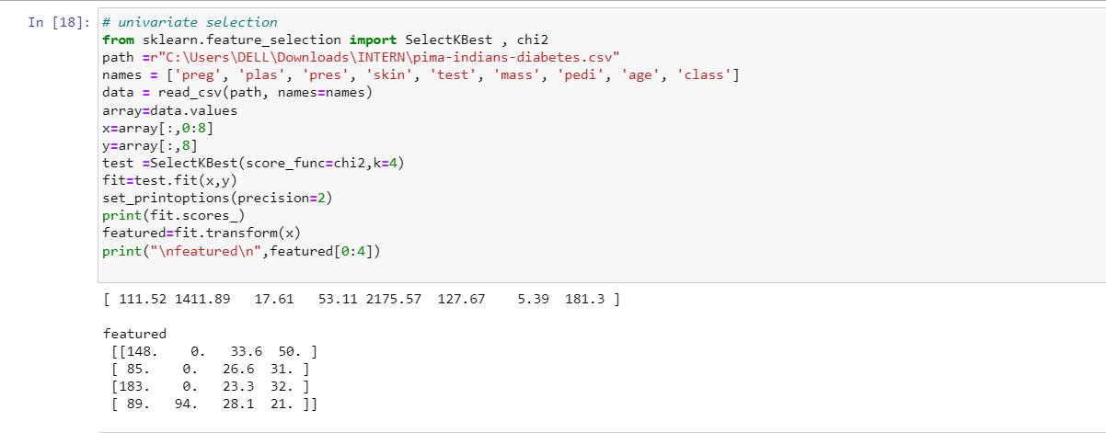
Univariate Selection

Slide 46
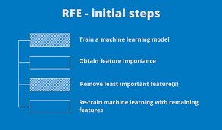
Data Feature Selection
Recursive Feature Elimination
It removes the attributes recursively and builds the model with remaining attributes. We can implement It with the help
of RFE class of scikit-learn Python
library.

Slide 47
Data Feature Selection
Feature Importance Feature importance technique is used to choose the importance features It basically uses a trained supervised classifier to select features. We can implement this feature selection technique with the help of ExtraTreesClassifier class of scikit-learn Python library. Note : The higher the score, higher is the importance of that attribute.

Slide 48
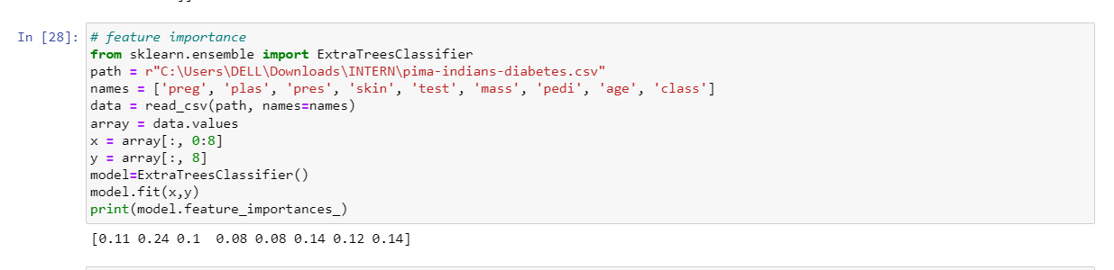
Feature Importance

Slide 49
THANKS
PRESENTED BY DANISH YOUSUF

